Slide 1
Hackerfarm Technology Workshop
Arduino Basics

Slide 2
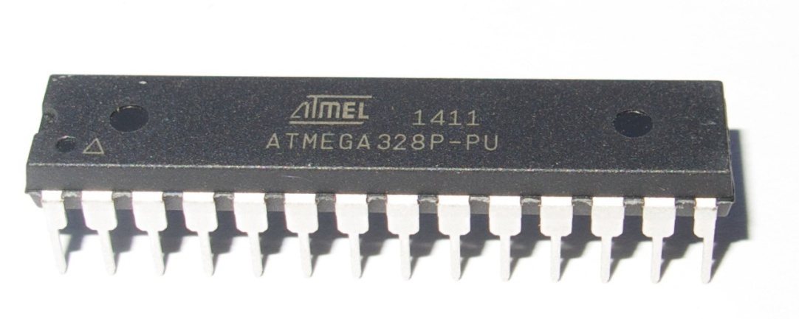
What is a Microcontroller?
A miniature programmable computer
Contains memory
  RAM
  Flash
Peripherals
  Serial communications
  Pulse Width Modulation
  Analog Digital Converter

Slide 3
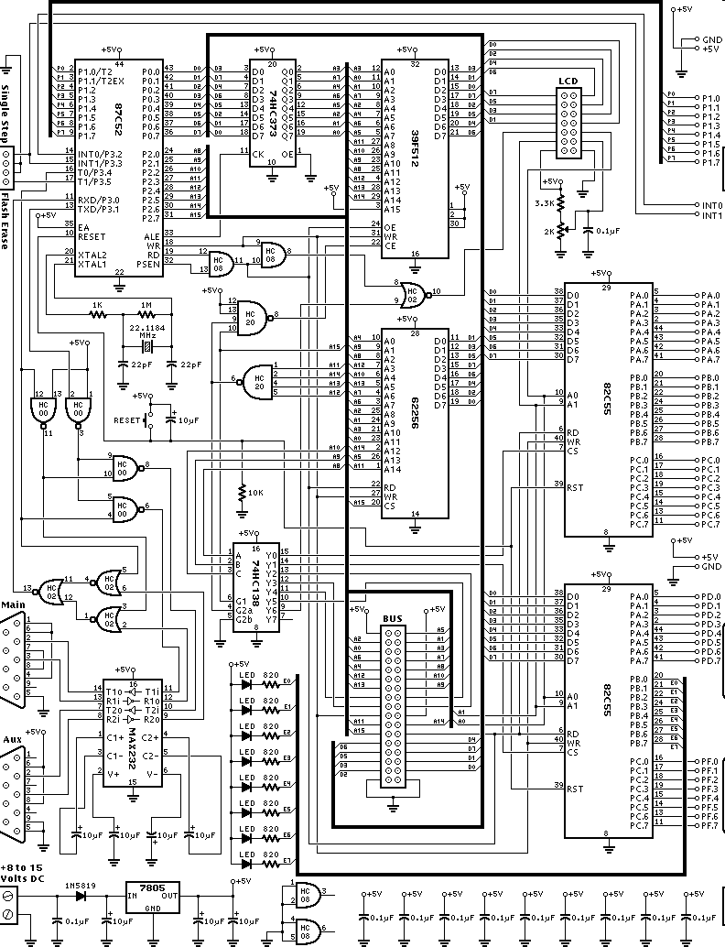
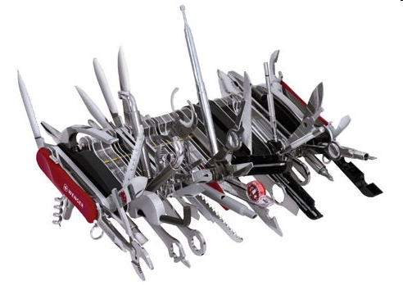
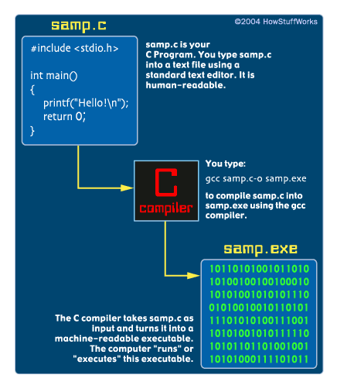
Traditional Microcontroller Programming
What makes embedded development difficult?
  Build tools
  Software internals
  Non standard hardware
Notes:
What makes embedded development difficult? It combines a complex toolchain, understanding of hardware at both the schematic level and logic level, and a deep understanding of programming and microcontroller architecture. The toolchain is probably one of the most complex things to set up and its probably what turns off a lot of people to embedded programming. The first lab is going to basically be a “hello world” type where we turn on an LED. It will also be a reality check where we make sure that the makefiles, compiler, downloader, and hardware are all working.

Slide 4
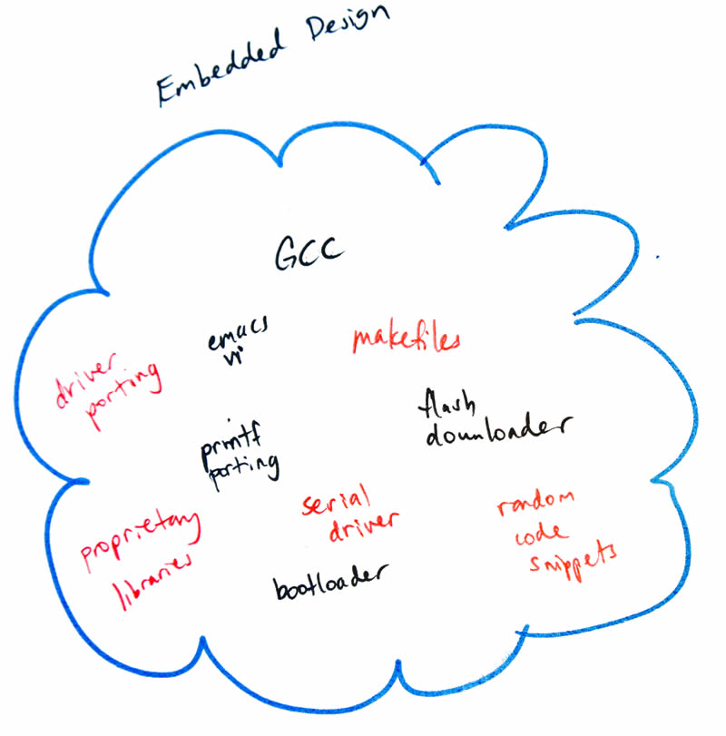
Traditional MCU Programming
Traditional embedded development is hard!
Notes:
What makes embedded development difficult? It combines a complex toolchain, understanding of hardware at both the schematic level and logic level, and a deep understanding of programming and microcontroller architecture. The toolchain is probably one of the most complex things to set up and its probably what turns off a lot of people to embedded programming. The first lab is going to basically be a “hello world” type where we turn on an LED. It will also be a reality check where we make sure that the makefiles, compiler, downloader, and hardware are all working.

Slide 5

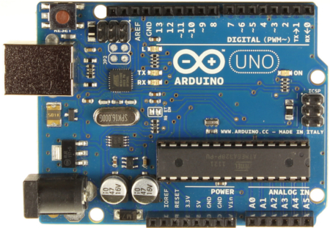
Arduino
That changed with Arduino

Slide 6
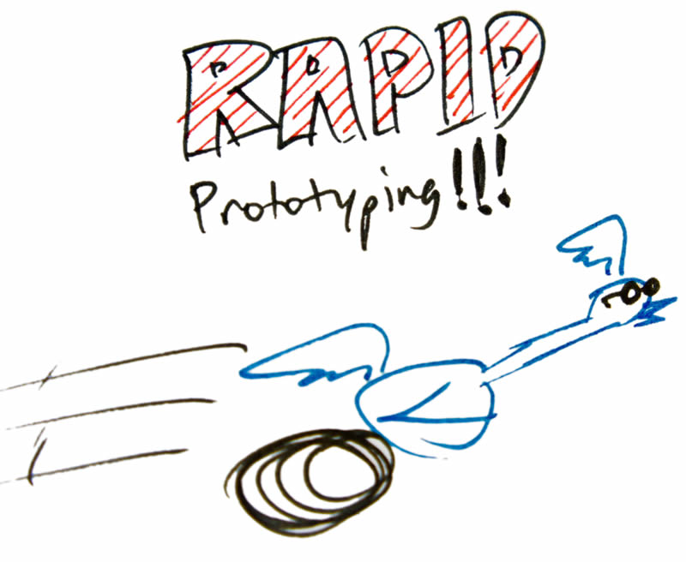
Arduino
Integrated SW Libs + Standardized HW + Huge community =

Slide 7
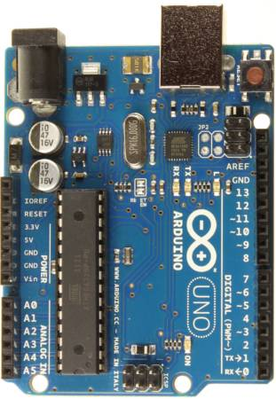
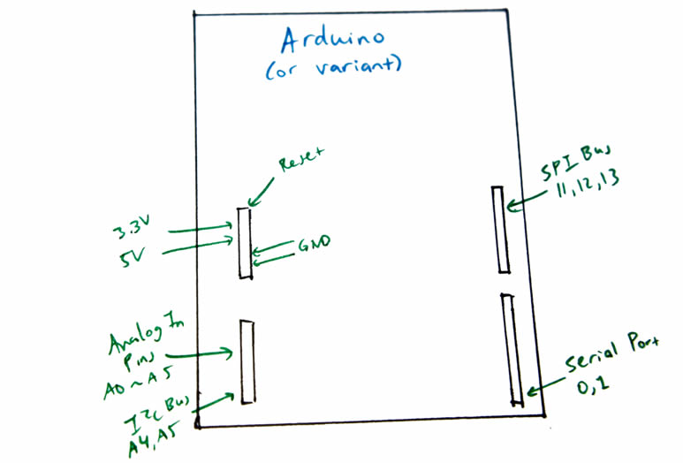
Arduino Hardware

Slide 8
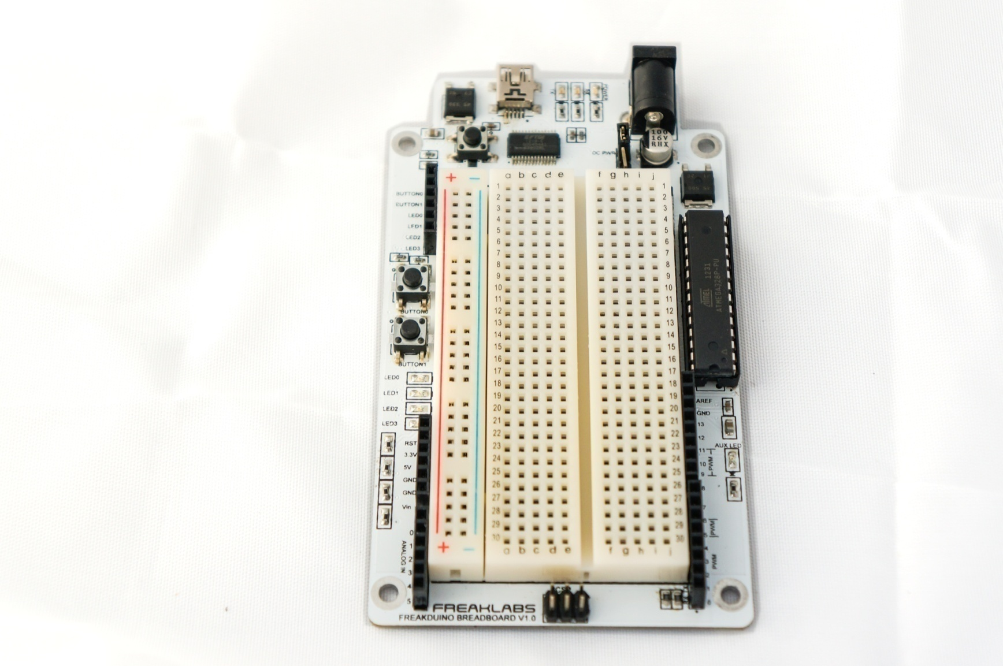
Freaklabs Fredboard

Slide 9
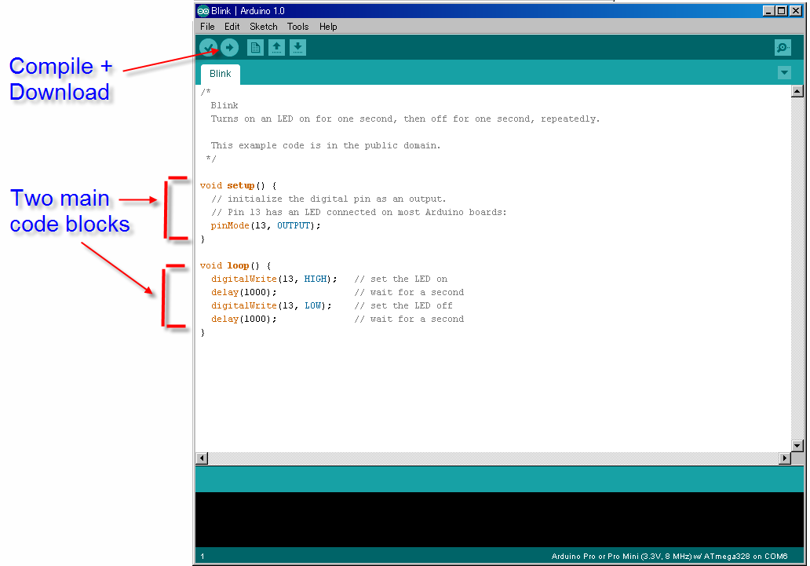
Arduino IDE

Slide 10
Arduino Sketch
Every sketch has these functions:
void setup()
  Runs once at the very beginning
  Set up your variables, peripherals
void loop()
  Runs forever
  Code that does actual work goes here

Slide 11
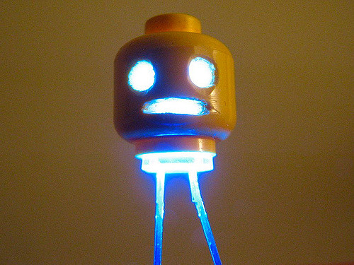

Lab 1 – Blink
Purpose:
  Sanity check
  Make sure system is working
  Blink an LED

Slide 12
Lab 1 – Blink
Goal: See the LED blink
Goal+ : Connect multiple LEDs and blink them
What are some potential applications of this?

Slide 13
Lab 1 – Blink
pinMode(pin, dir)
  pin = pin number
  dir = INPUT or OUTPUT
digitalWrite(pin, val)
  pin = pin number
  val = LOW or HIGH or 0 or 1

Slide 14
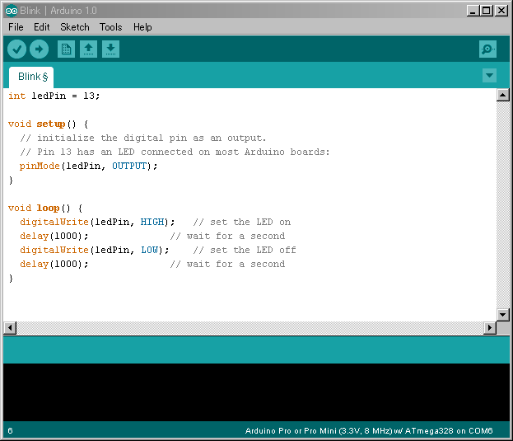

Slide 15
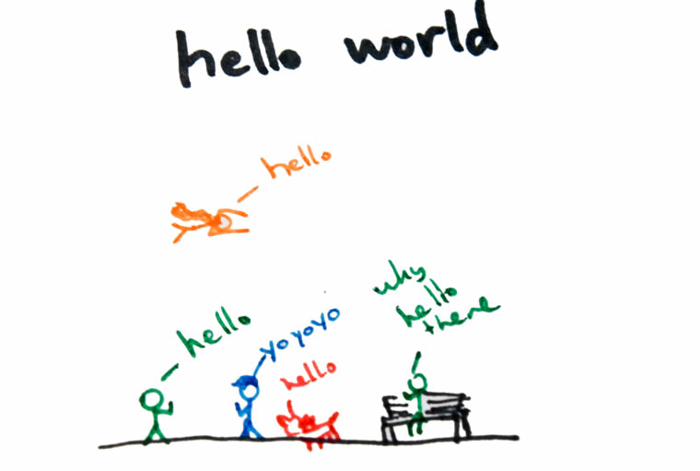
Lab 2 – Hello World
Purpose:
  Sanity check
  Make sure system is working

Slide 16
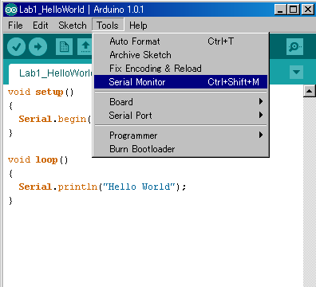
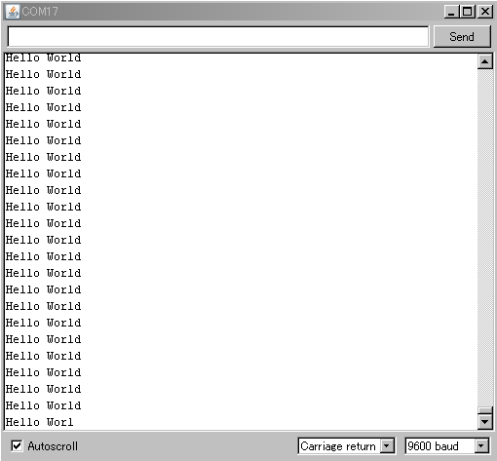
Lab 2 – Hello World
Goal: View serial output from your sketch with the built in serial monitor
Why do we care about serial printouts?

Slide 17
Lab 2 – Hello World
Serial.begin(speed)
  initializes serial port at given speed
Serial.print(string)
  prints string
Serial.println(string)
  prints string + trailing newline

Slide 18
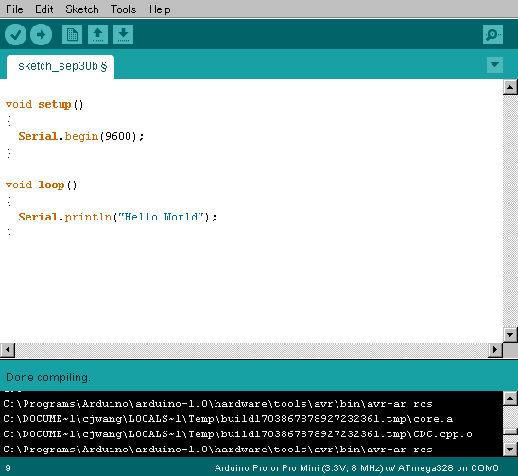

Slide 19
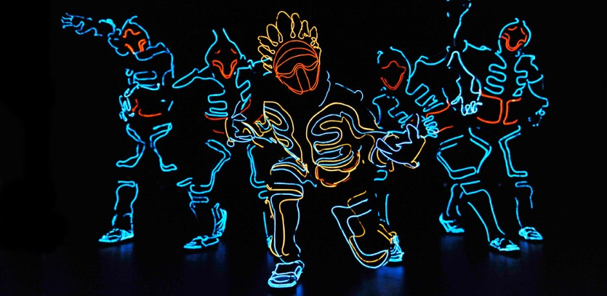
Lab 3 – Fade
Purpose:
  Understand PWM
  Introduction to conditionals
  Introduction to loops

Slide 20
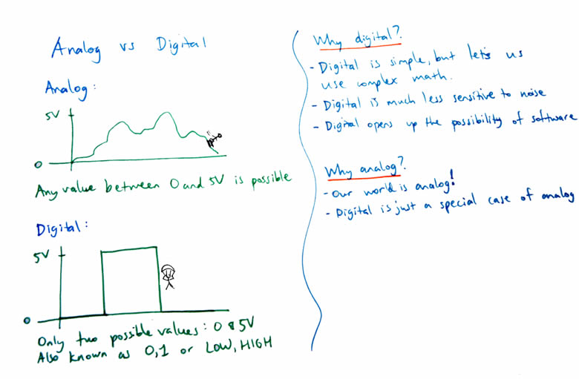
Analog vs Digital

Slide 21
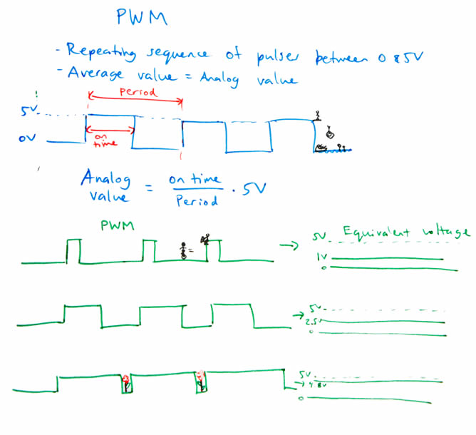
Pulse Width Modulation
PWM – Method to generate analog voltages from digital voltages

Slide 22
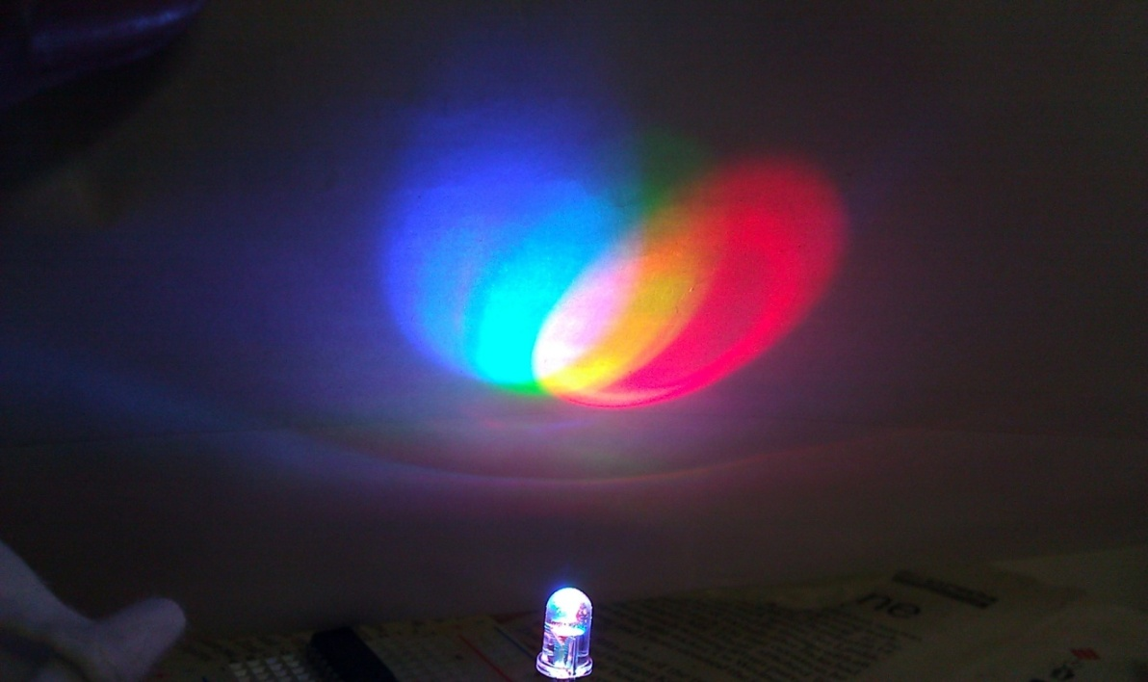
Lab 3 – Fade
Goal: Fade an LED all the way on and then all the way off
Why is fading an important concept?

Slide 23
Lab 3 - Fade
If/else
for
analogWrite(pin, val)
  pin = pin number
  val = 0 to 255
  uses PWM
  only for certain pins
delay(time)
  blocking delay in msec
  time = msec

Slide 24
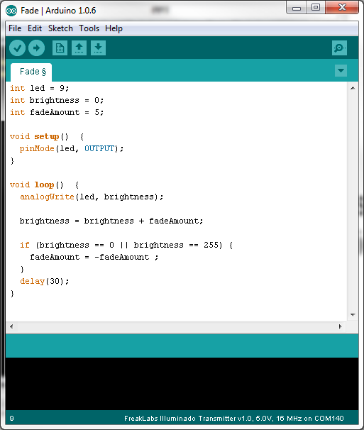

Slide 25
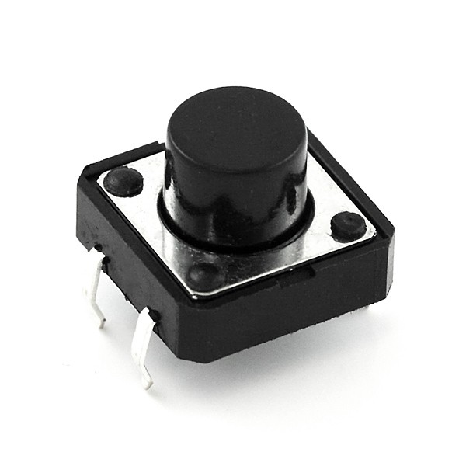
Lab 4 - Button
Purpose:
  Demonstrate reading a digital value
  Interface a button to an Arduino system

Slide 26
Lab 4 - Button
Goal: Read a button and print out the value
Goal+: Read a button and have the value print out once
Goal++: Read a button and depending on the state, light an LED
What are potential applications of reading button pushes?

Slide 27
Lab 4 - Button
val = digitalRead(pin)
  returns the value of a digital signal
  returned value will be 0 or 1
You’ll see a problem with the code once you run it
  How can you solve it
  Also need to deal with debounce issues
  Buttons look easy but are actually complicated to deal with properly

Slide 28
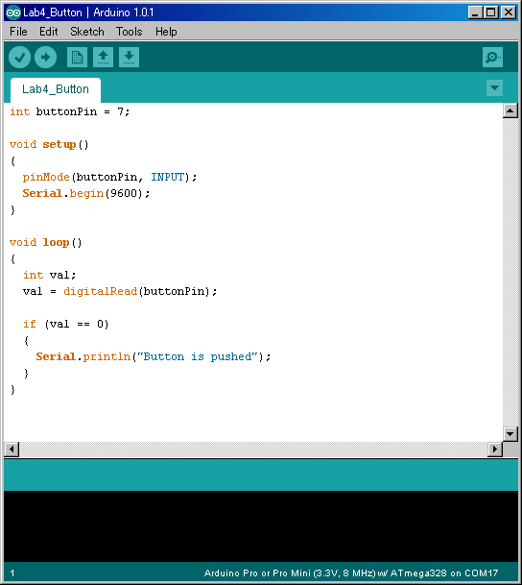

Slide 29
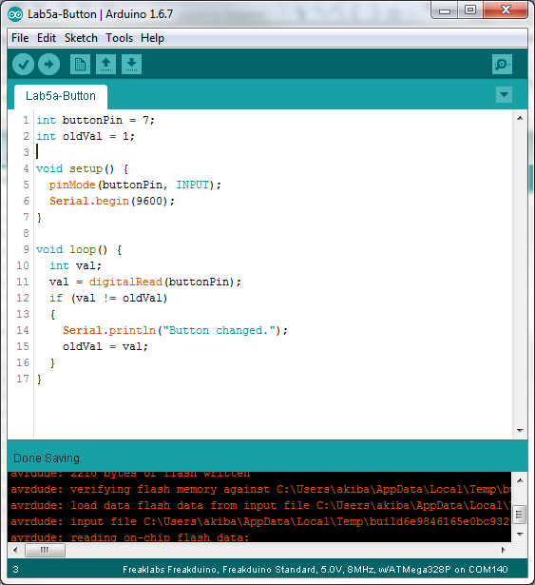

Slide 30
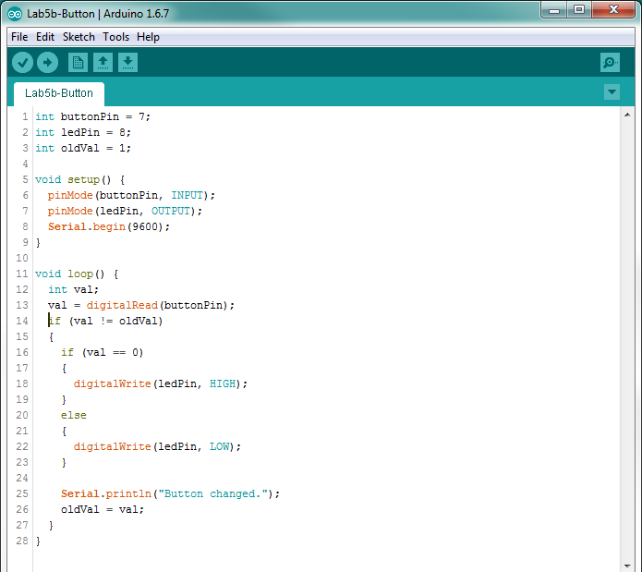

Slide 31
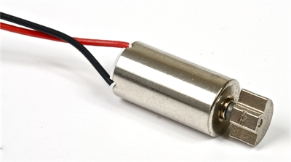
Lab 5 – Vibration Motor
Purpose:
  Control a motor interactively

Slide 32
Lab 5 – Vibration Motor
Goal: Turn a motor on when a button is pushed
Goal+: “Fade” the motor in and out
What are potential applications of this?

Slide 33
Lab 5 – Vibration Motor
Hardware connection
  Red = 5V
  Blue = GND
For “fading” the motor, reuse the fade code you wrote in the previous lab

Slide 34
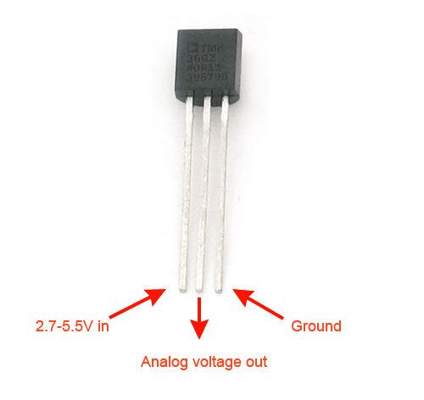
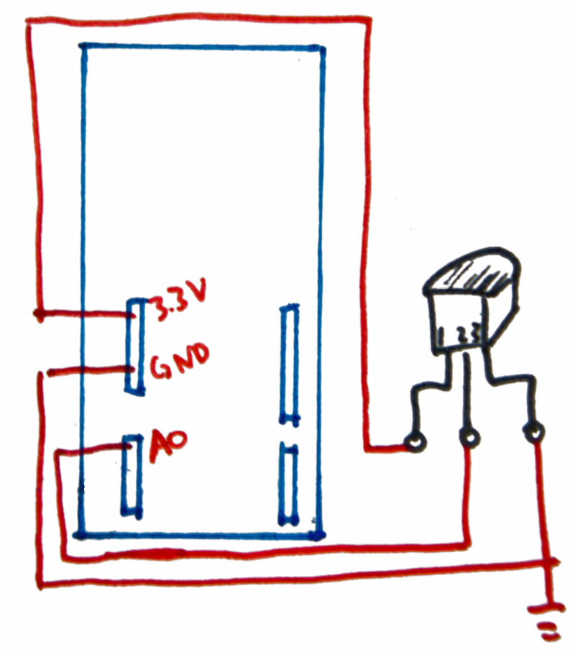
Lab 6 – Temperature Sensor
Purpose:
  Interface an analog sensor to an Arduino system
  Read analog values from the analog input pins

Slide 35
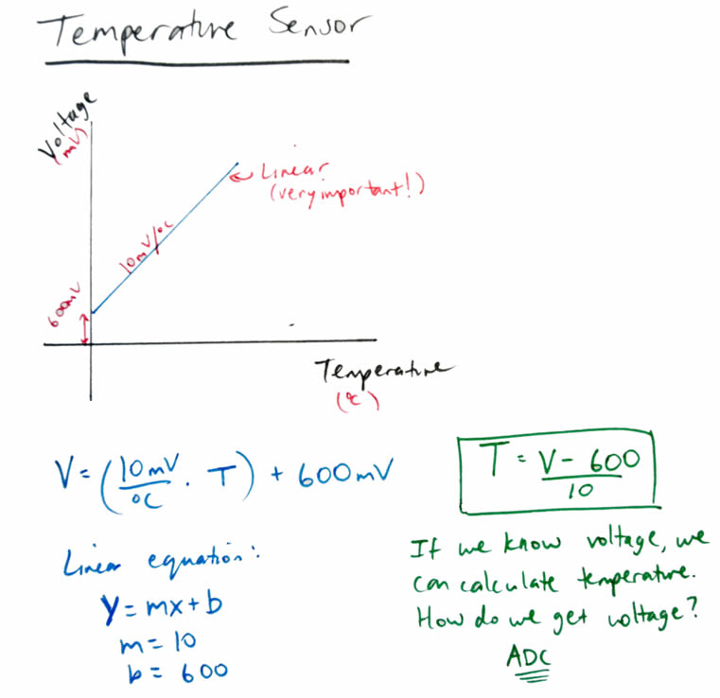
Lab 6 – Temperature Sensor

Slide 36
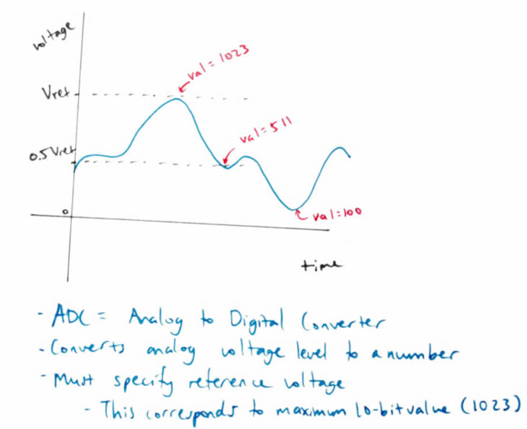
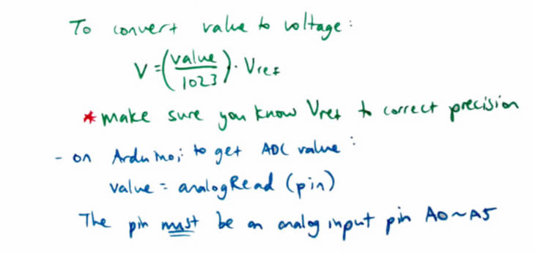
ADC

Slide 37
Lab 6 – Temperature Sensor
Goal: Read an analog value from temperature sensor and convert to meaningful data
What are potential applications of this?

Slide 38
Lab 6 – Temperature Sensor
float
analogRead(pin)
  Returns analog value between 0 and 1023
  Conversion to voltage:
  V = val/1023 * 5.0
Temperature conversion
  Temp = (Voltage – 0.6) * 100

Slide 39
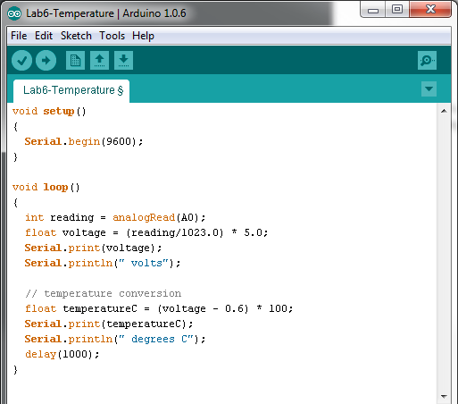

Slide 40
Lab 7 – Liquid Crystal Display
Purpose: Display messages on an LCD

Slide 41
Lab 7 – Liquid Crystal Display
Goal: Interface an LCD to the Arduino and write messages to it. Verify messages are displayed on LCD.

Slide 42
Lab 7 – Liquid Crystal Display
Using Libraries
  #include <….>
Using library functions
I2C
  Serial protocol for communications
Object creation (instantiation)

Slide 43
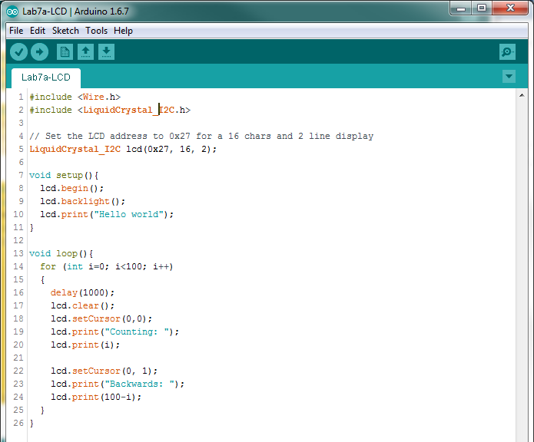

Slide 44
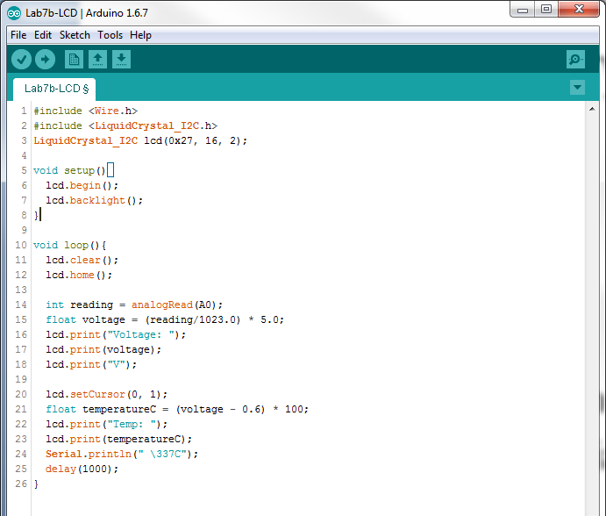

Slide 45
Lab 8 – Humidity Sensing
Purpose: Read a humidity sensor and print humidity and temperature to an LCD

Slide 46
Lab 8 – Humidity Sensing
Goal: Read environmental data like humidity and temperature and display on LCD

Slide 47
Lab 8 – Humidity Sensing
Hardware Connection:
  Humidity Sensor:
  VCC: 5V
  GND: GND
  DAT: Pin 2

Slide 48
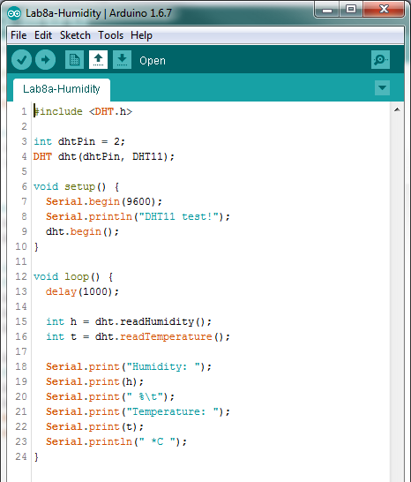

Slide 49
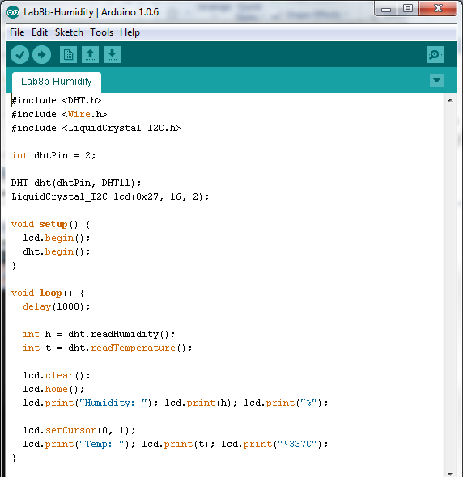

Slide 50
Finished!!!
Congratulations ☺

